Slide 1

IT Application and Data Security
- Dr. Gopal Rawat

Slide 2
IT Application and Data Security
Information technology (IT) is the use of any computers, storage, networking and other physical devices, infrastructure and processes to create, process, store, secure and exchange all forms of electronic data.
Application is a computer software package that performs a specific function for an end user or another application based on carefully designed features.
Data is information that has been translated into a form that is efficient for movement or processing.
Security is protection from, or resilience against, potential harm caused by others, by restraining the freedom of others to act.

Slide 3
Background
Data comprises of any facts, numbers, texts that can be processed, organized and disseminated by computer.
Data can reside on personal computer or can be stored inside massive servers.
Security is required to not only protect data from viruses but also from unauthorized access.
Data protection comprises of various elements: where it resides, who uses it and who has access to it.

Slide 4

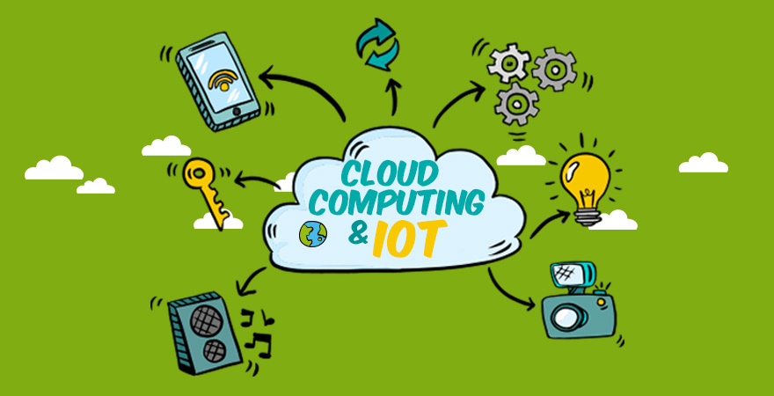
Background
Digital era
Interconnected world
Huge amount of data every second
(social, official, financial … )

Slide 5
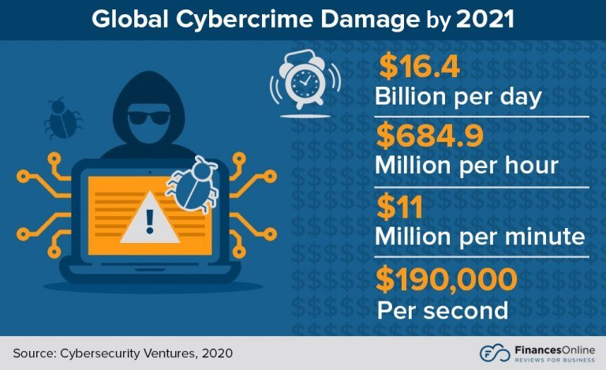
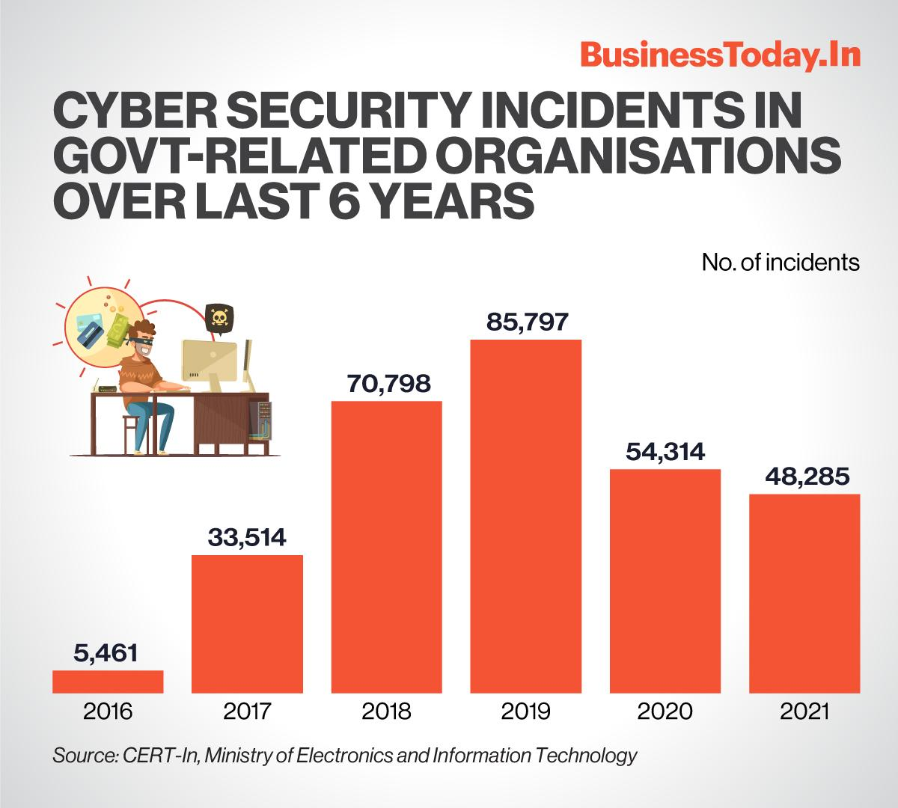
Facts and Figures
For any organization, data security is a vital issue. They can suffer serious issues if an user who is not authorized to gain access to their data enters their systems

Slide 6
IT Data Security – Data Security Threats
Data Breach - security violation, in which sensitive, protected or confidential data is copied, transmitted, viewed, stolen, altered or used by an individual unauthorized to do so
Twitter – user’s data sold on dark web during 2022
Uber
Facebook/Cambridge Analytica
Cisco

Slide 7
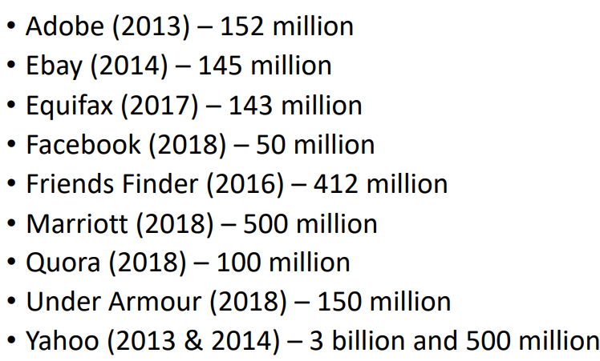
Data Breach

Slide 8
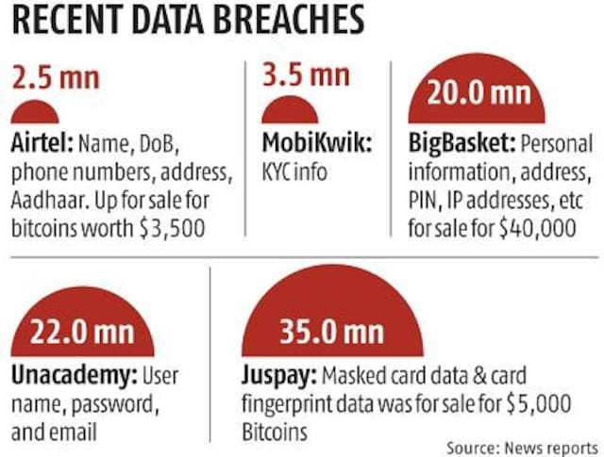
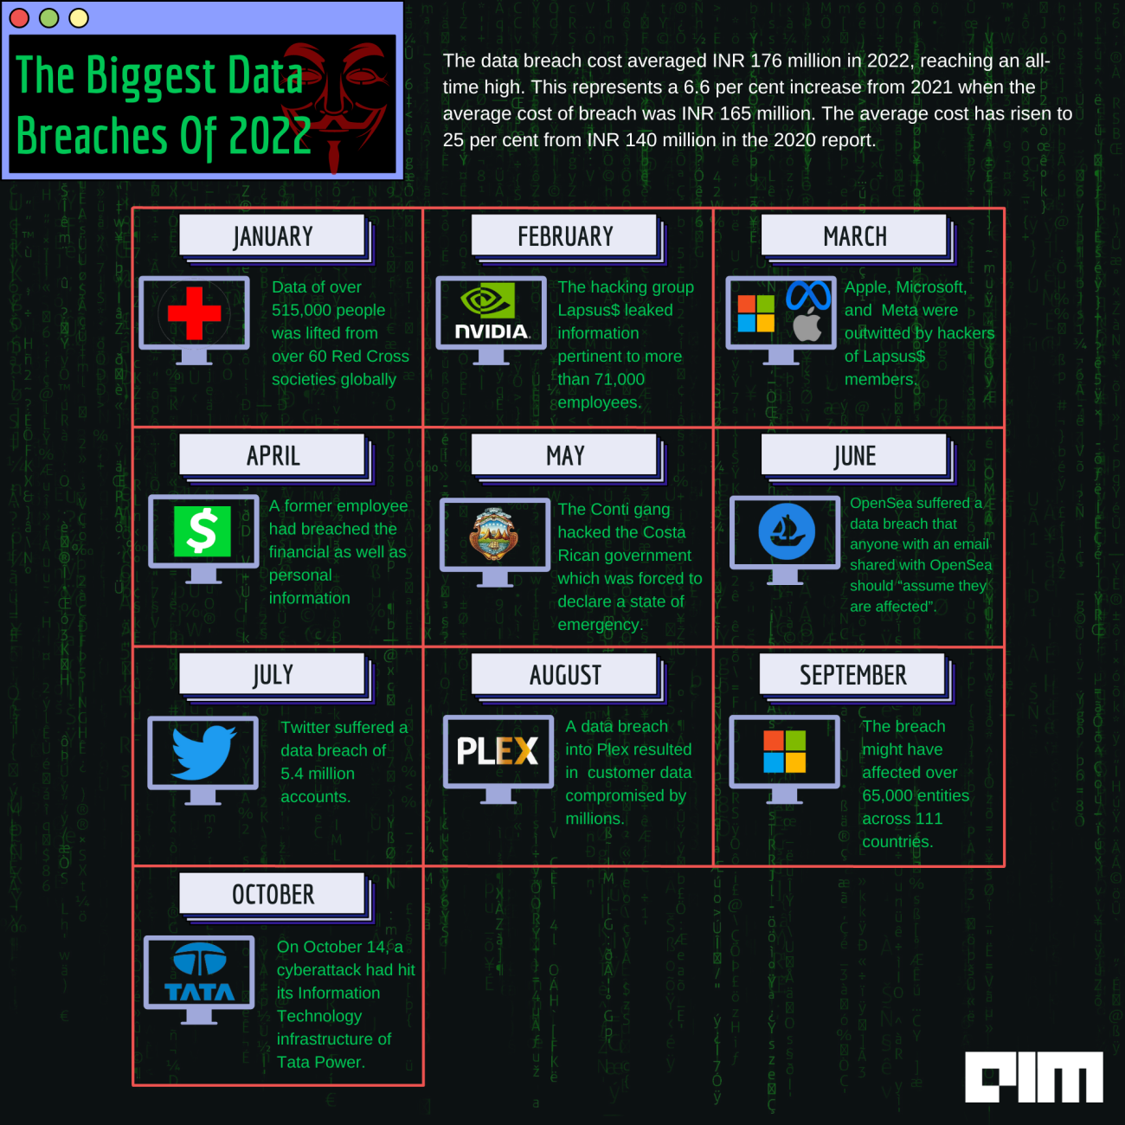
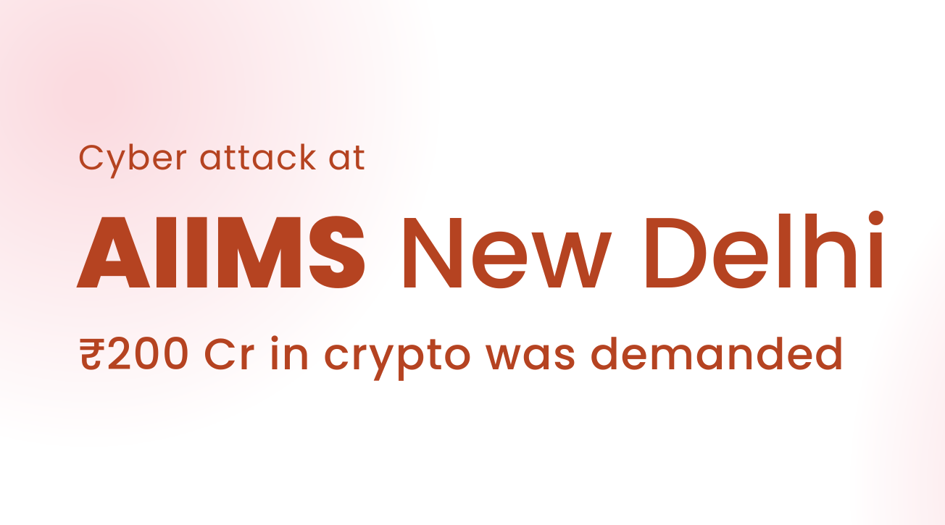

Slide 9
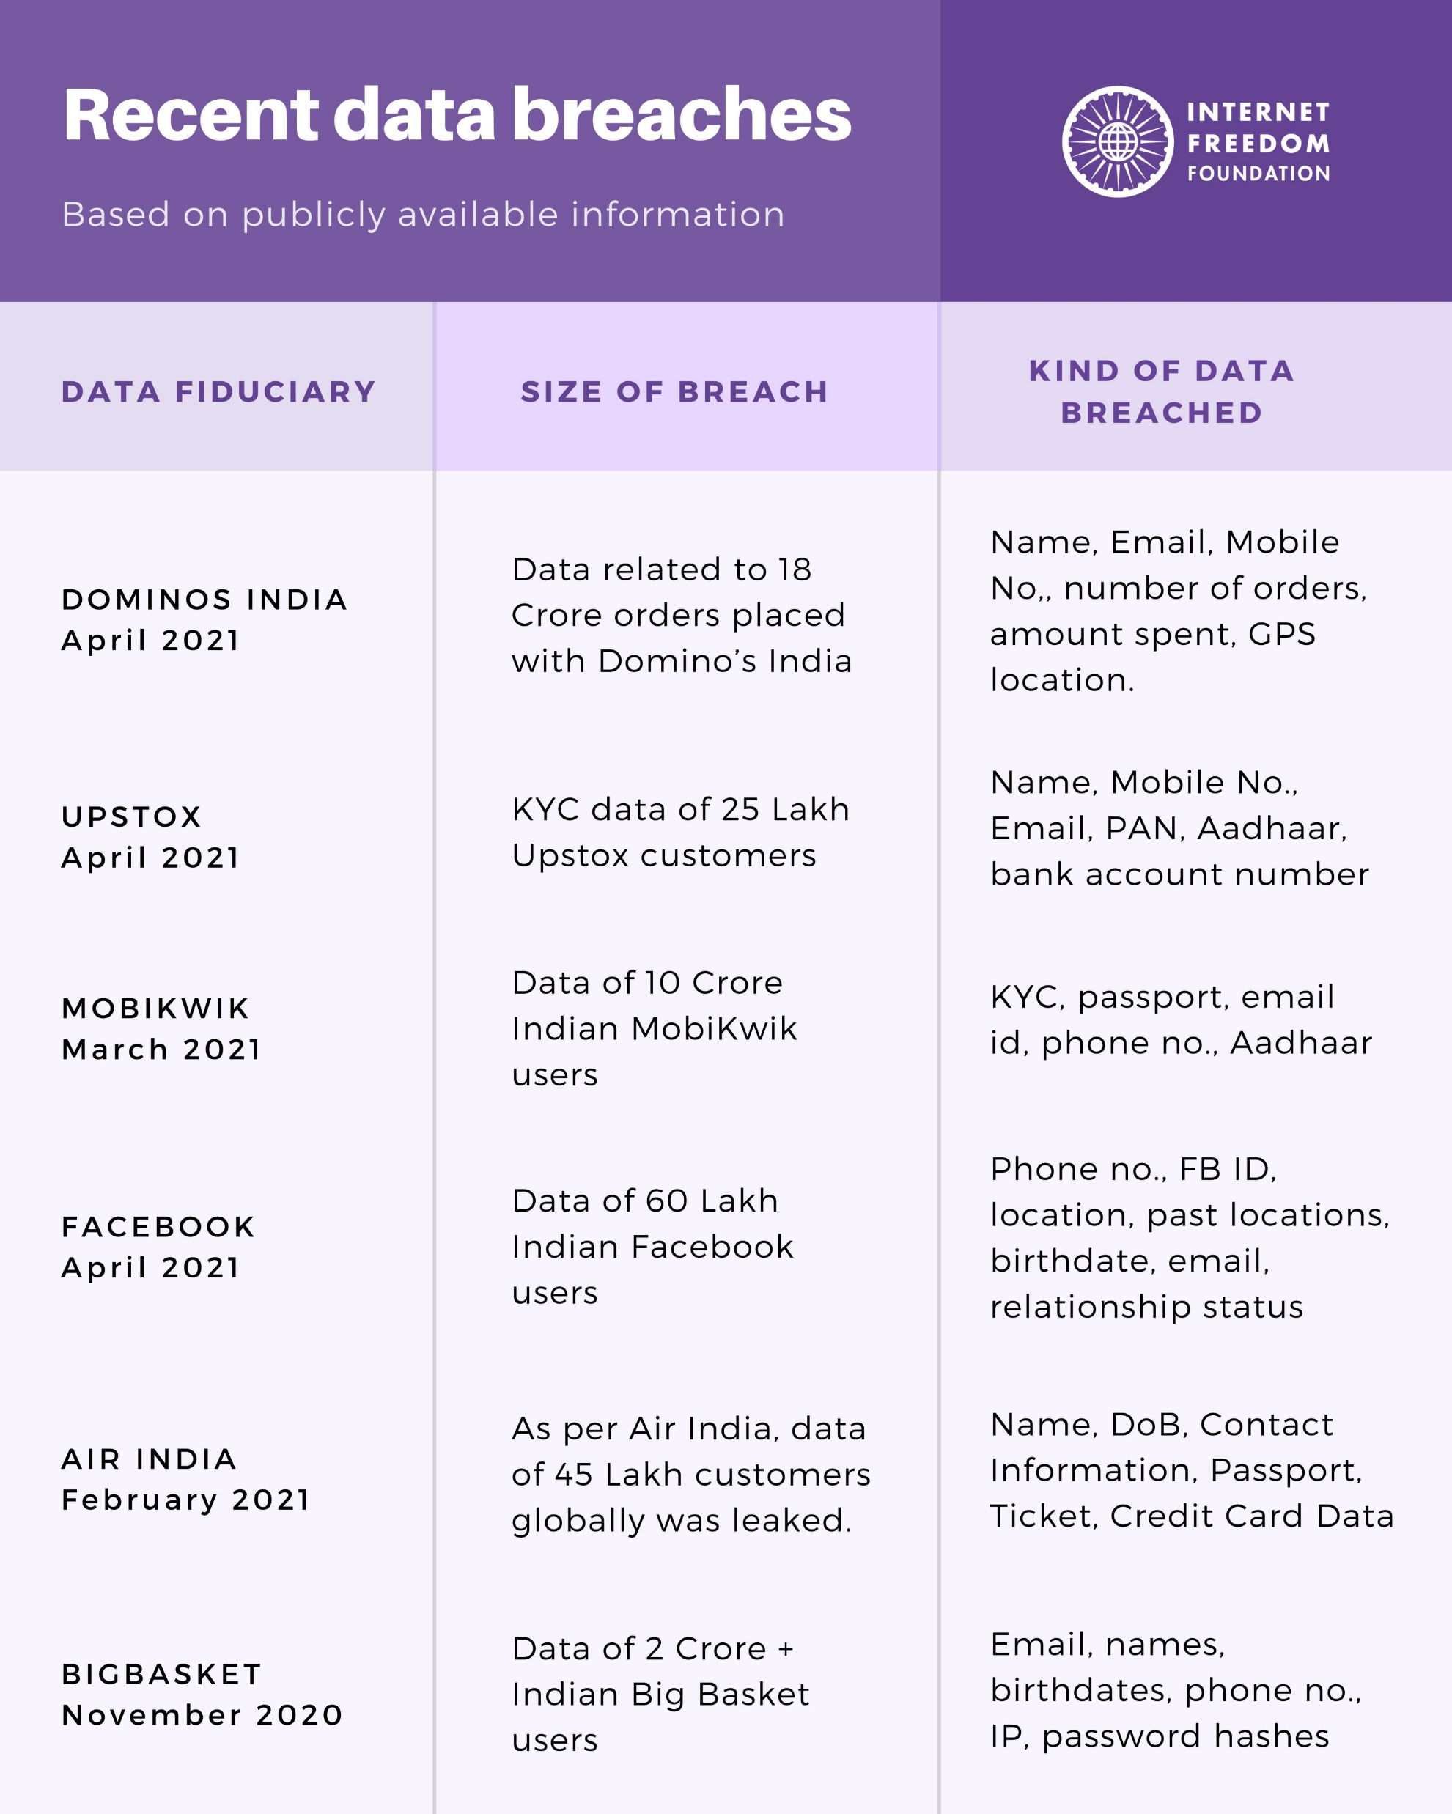
IT Data Security – Data Security Threats
Case Study
Air India : Feb 2021, access to system for 22 days
personal details of about 4.5 million customers around the world were compromised (passport, credit card details, birth dates, name and ticket information)

Slide 10
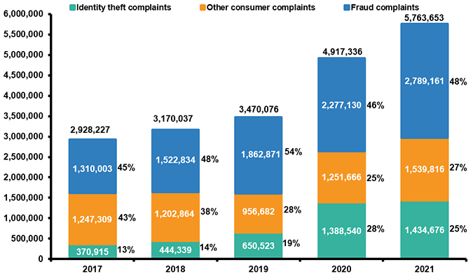
Identity Theft
Identity theft is the crime of obtaining the personal or financial information of another person to use their identity to commit fraud
making unauthorized transactions or purchases
Damage to their credit, finances, and reputation.

Slide 11
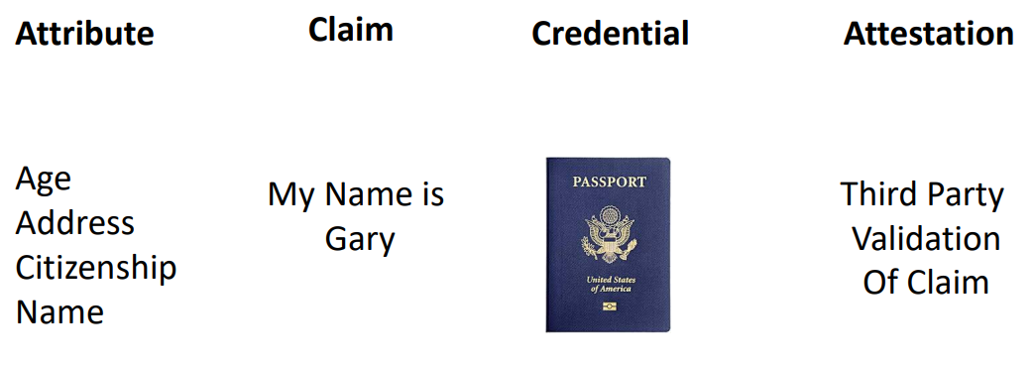
Concepts of Identity

Slide 12
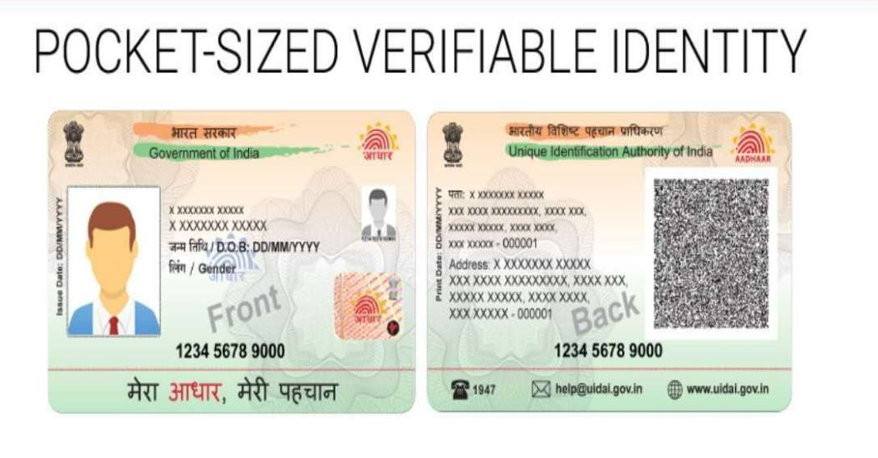
State Identity Projects
India – Aadhaar - National Identification System
• 12-digit ID
• Biometrics – fingerprint and iris scan
Hacking is a violation of right to privacy under Article 21 of the Constitution of India and violates the fundamental right
Notes:
Polyvinyl Chloride (PVC)

Slide 13
Identity Theft - Types
Financial Identity theft
Medical Identity Theft
Online Identity theft
Social Security Identity Theft
Tax Identity Theft
Criminal Identity Theft
Case Study : Dhani Loan App

Slide 14
Identity Theft: Tactics
Ways your identity can be stolen?
Phishing /SMiShing/Vishing
Dumpster Diving
Wireless Hacking
Fake Lottery Winnings, Jobs, Etc.
ATM and Payment Machines
shoulder surf or rig devices to steal information (skimming)
Notes:
Protect yourself by avoiding online banking on public WIFI networks and make sure your home network is secured

Slide 15
Identity Theft : Prevention
Update your passwords
No same passwords
Don’t save credentials
Use updated software
Never disclose your data
Avoid unsafe ATMs
Shred or discard imp documents
Opt for two-factor authentication
Use privacy/proxy account

Slide 16
Identity Theft : Legalities
Notify the authorities
Alert the Department of Telecommunications if your identity is used to obtain a SIM card
If passwords have been compromised or your system has been affected contact cybercrime officer
Indian Penal Code 1860 (IPC)
IPC sections 419 and 420 pertain to cheating by personation which can be construed as identity theft
penalties range from imprisonment for two (2) years to ten (10) years along with fines imposed
Information Technology Act 2000 (IT Act 2000)
Section 66C of the IT Act 2000 provides punishment for identity theft up to three (3) years and / or fines up to one (1) lakh rupees

Slide 17
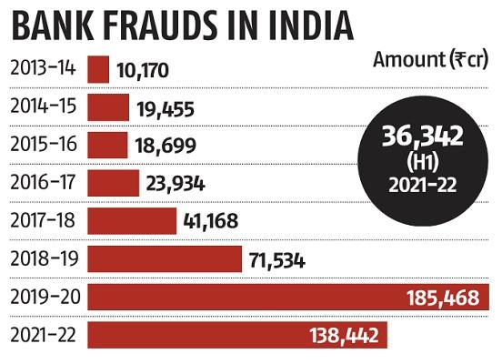
Bank Fraud
use of potentially illegal means to obtain money, assets, or other property owned or held by a financial institution
or
to obtain money from depositors by fraudulently posing as a bank or other financial institution
More read : All about banking fraud - The what, why, and how - NetGuardians

Slide 18
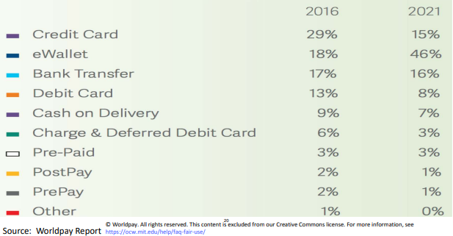
Global Payment Methods

Slide 19
Bank Fraud - Types
External
Outsider manages to penetrate the bank’s data security and access sensitive information or carry out fraudulent transactions
Internal
Employees with user privileges that give them high levels of access to the bank’s IT systems, such as systems and database administrators

Slide 20
Bank Fraud - Types
Phishing
Vishing
Online sales platforms
Unknown/Unverified Apps
ATM card skimming
Remote access/Screen sharing app
SIM cloning or swap
Compromising credentials(data leak)
QR code scan
Social Media Impersonation
Money laundering
Juice jacking
Reserve Bank of India - Notifications (rbi.org.in)

Slide 21
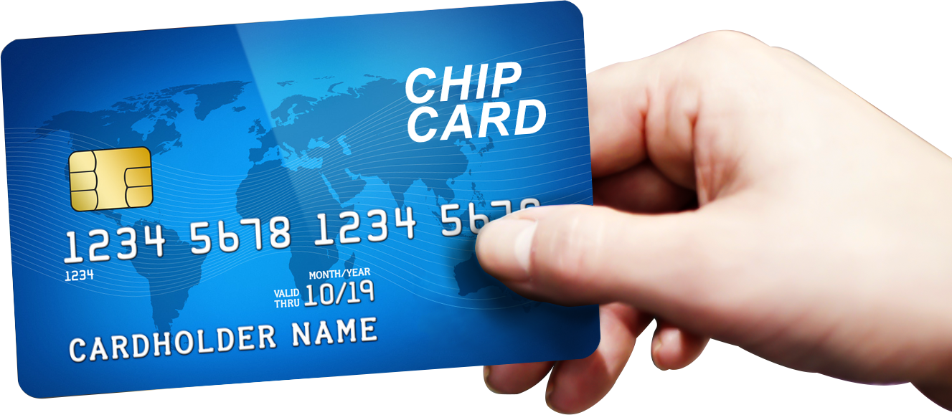
Bank Frauds- Chip Card
chip card is a standard-size plastic debit or credit card that contains an embedded microchip as well as a traditional magnetic stripe
chip encrypts information to increase data security when making transactions at stores, terminals, or automated teller machines (ATMs)
Other names Smart Card , EMV
Standards exist, based on ISO/IEC 7816, for contact cards, and based on ISO/IEC 14443 for contactless cards

Slide 22
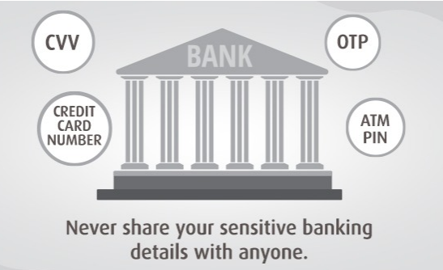
Bank Frauds: Prevention
Multi-Factor Authentication
Banks: Monitor Transactions
Raise Fraud Awareness
BEAWARE07032022.pdf (rbi.org.in)

Slide 23
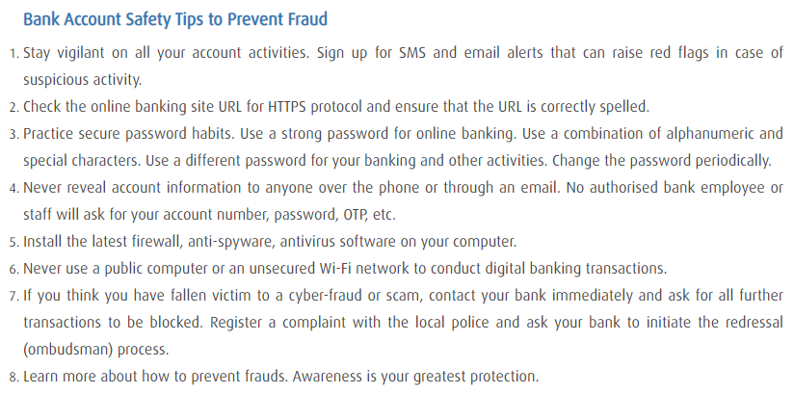
Bank Frauds: Prevention

Slide 24
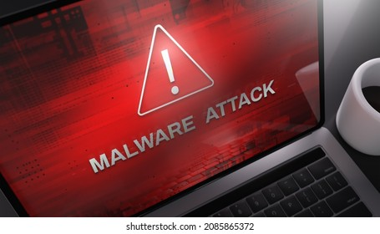
Malware
Malware is intrusive software that is designed to damage and destroy computers and computer systems.
Malware is a contraction for “malicious software.”
Examples of common malware includes viruses, worms, Trojan, spyware, adware, and ransomware.

Slide 25
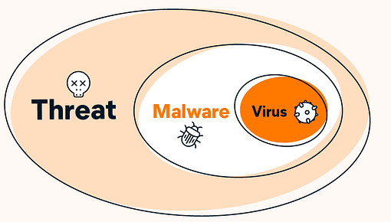
Malware
All malware variants share two defining traits:
they’re sneaky
they’re actively working against your best interests
Notes:
Threats encompass malware, and also include other online threats like phishing, identity theft, SQL injection, and more.

Slide 26
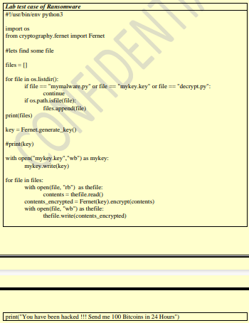

Slide 27
Malware: Virus
A computer virus is designed to copy itself and spread to other devices as widely as possible.
proliferate by infecting applications and email
can be transmitted by removable storage, infected websites, email attachments, and even networking routers
what the virus does depends on its level of sophistication
Simple malicious code damages your hard disk or deletes files
A more complex virus might hide on your computer and engage in unwanted activity such as spewing out spam
Highly advanced viruses, called polymorphic viruses, modify their own code to evade detection

Slide 28

Malware: Virus
Dormant phase
Propagation phase
Triggering phase
Execution phase
Eg: Melissa, CIH

Slide 29
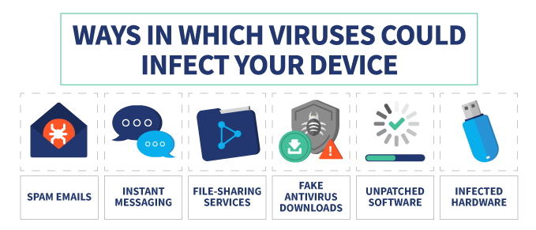
Malware: Virus
Spread:
Emails
Downloads
Messaging services
Old Software
Malvertising

Slide 30
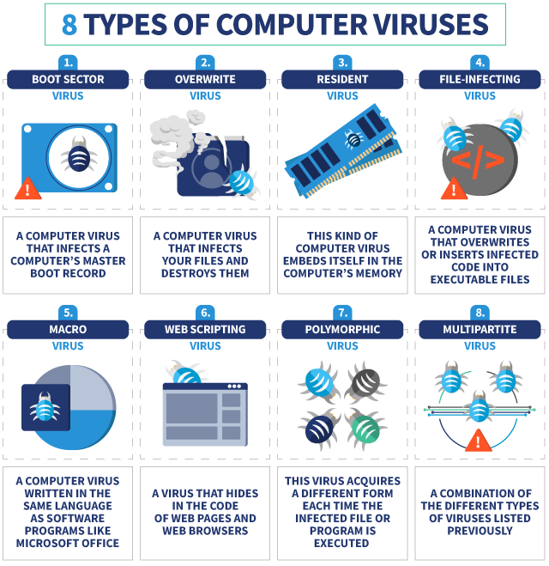
Malware: Virus

Slide 31
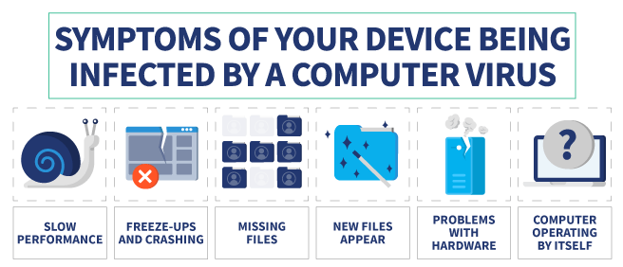
Malware: Virus
Effects unleashed
Slow or stuttering performance
Corrupted or deleted files
Incessant pop-ups or adware
Program failure and operating system crashes
A constantly spinning hard drive
Malfunctioning apps, files, and other programs

Slide 32
Malware: Virus Prevention
Antivirus Software
Updated and Genuine Software
Enable firewall
Don’t open suspicious emails or attachments
Adjust privacy settings (device and browser)

Slide 33
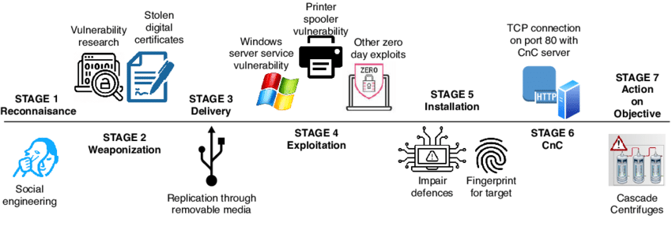
STUXNET virus
Notes:
command-and-control server (C&C) server or C2 server.

Slide 34
Malware: Worm
A self-replicating piece of malware whose primary function is to jump from computer to computer, often without doing anything beyond replication
key difference between a computer worm and a virus is how a worm can spread copies of itself to uninfected machines completely on its own
self-sufficient malware able to execute and proliferate without user interaction
Worms get the job done by exploiting hidden vulnerabilities
“USB flash drive, email, instant messaging services, and file-sharing networks ”

Slide 35
Rabbits & Bacteria
Consider the shell script program below presented by Dennis Ritchie.
while true
do
mkdir x
chdir x
done
The above shell script will quickly exhaust either disk space or the inode tables.

Slide 36
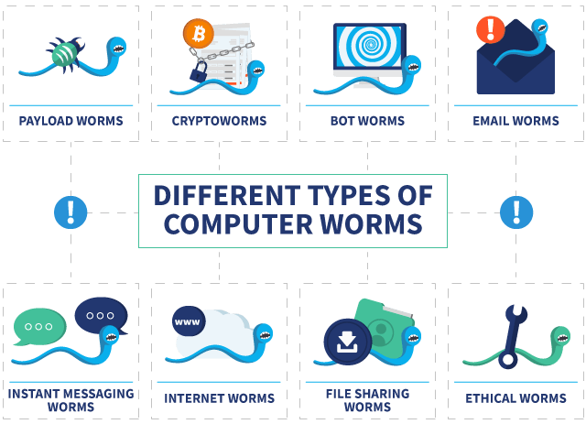
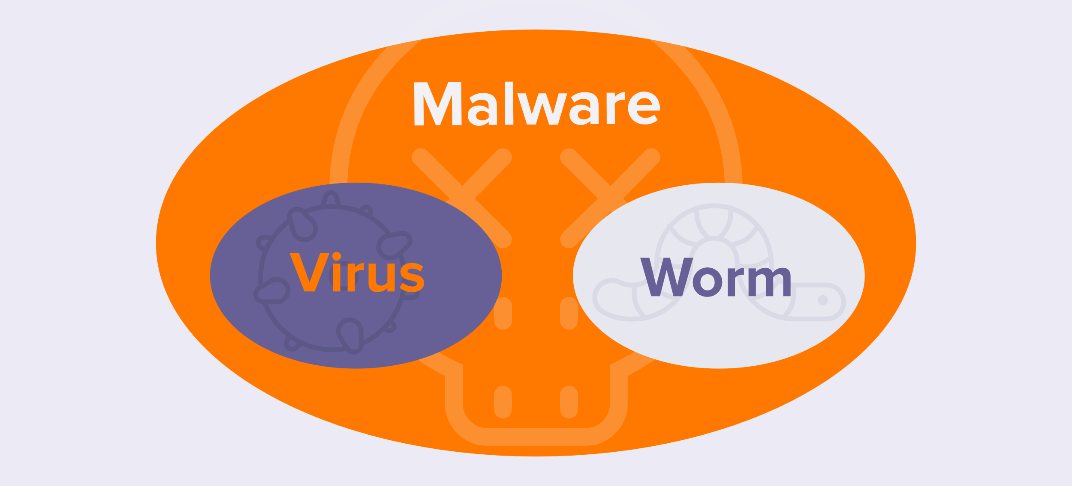
Malware: Worm
Morris worm (1988)
WannaCry worm(2017)

Slide 37
Malware: Worm Prevention
Never open strange email attachments
Don’t click weird links
Don’t use P2P programs
Don’t click on sketchy ads
Use current genuine software
Use antivirus software
Use strong, unique passwords

Slide 38
Malware: Adware
CONGRATULATIONS!!! YOU’VE BEEN SELECTED FOR A FREE IPHONE!!!!
CLICK HERE!!!!
it’s software that hijacks your browser or other parts of your system in order to blast you with unwanted ads
legitimate software, just with some (annoying) ads
malware that can gather your personal information by tracking the websites you visit or recording your keystrokes

Slide 39

Malware: Adware Prevention
Use a trusted ad blocker
Don’t click on ads that seem too good to be true
Ignore fake warnings
Avoid shady websites
Adjust your browser’s privacy settings
Use strong antivirus software

Slide 40
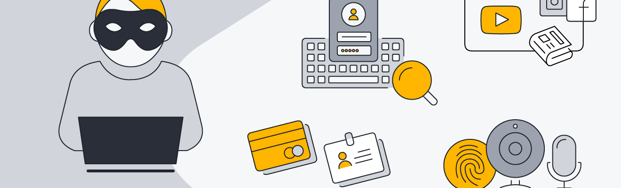
Malware: Spyware
Spyware is a program installed on your computer, usually without your explicit knowledge, that captures and transmits personal information or Internet browsing habits and details to its user
Some strains of spyware are also capable of activating cameras and microphones to watch and listen to you undetected.
Used by law enforcement, government agencies and information security organizations to test and monitor communications in a sensitive environment or in an investigation

Slide 41
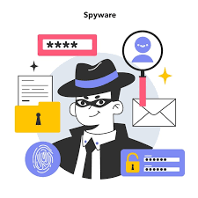
Malware: Spyware
Keylogging
Recording audio and video, and screenshot capture
Remote control of the device
Capturing content from email, messaging, and social apps
Recording and capturing browser history

Slide 42
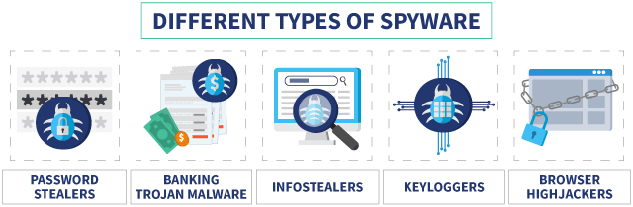
Malware: Spyware
Adware
Keyloggers
Infostealers
Cookies
Rootkits
- Firmware/ Bootloader/Kernel mode/Memory
Red Shell – tracks data and sells to 3rd parties

Slide 43
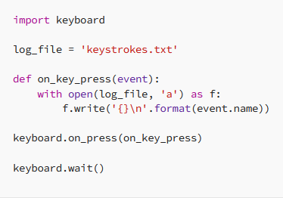
Simple Keylogger

Slide 44
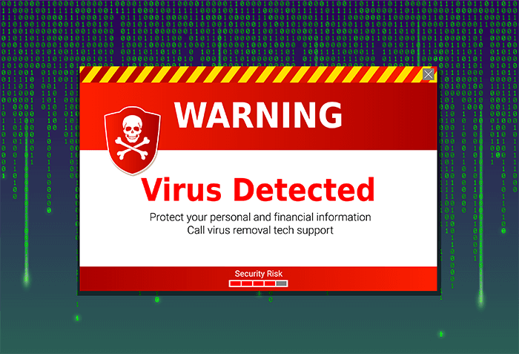
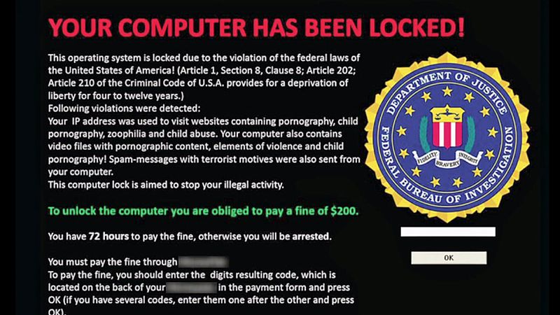
Malware: Scareware
Cybercriminals scare us into thinking that our computers or smartphones have become infected to convince victims to purchase a fake application
“Warning: Your computer is infected!” or “You have a virus!”
Can be removed easily

Slide 45
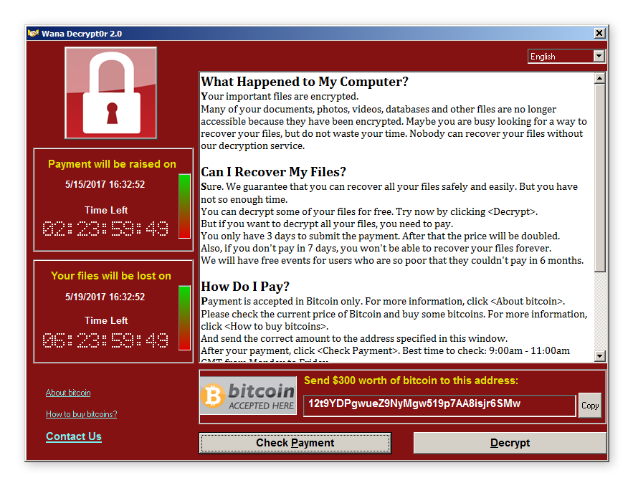
Malware: Ransomware
Malware that encrypts files and even entire computer systems, then demands a ransom payment in exchange for returning access.
uses encryption to block access to infected files or computer systems, making them unusable to the victims
attacks target all kinds of files, from personal to business-critical
unlock the computer or decrypt files after a ransom is paid

Slide 46
Malware: Ransomware
Filecoders
Screenlockers
Doxxing
- act of revealing someone’s personal information online
- aim of humiliating or bullying a victim
Scareware
Example
Wannacry, Cryptolocker, BadRabbit
Ref : Bad Rabbit ransomware | Securelist

Slide 47
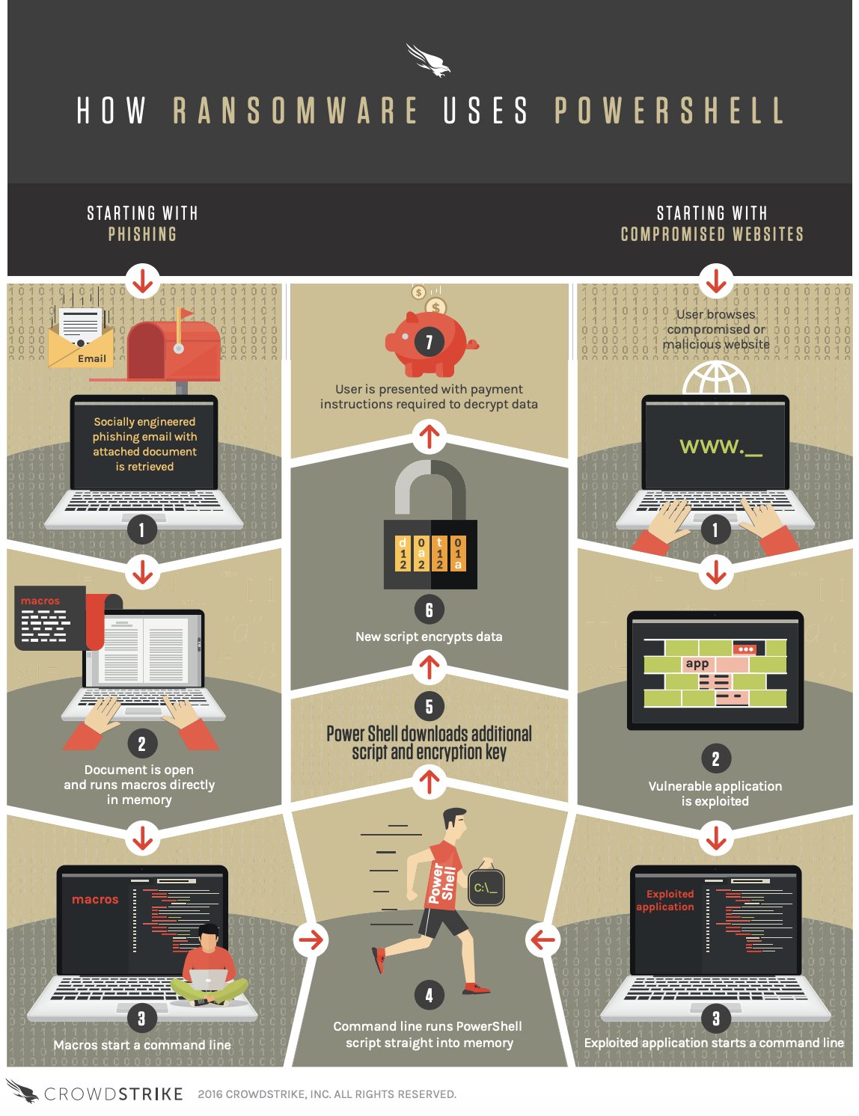

Slide 48
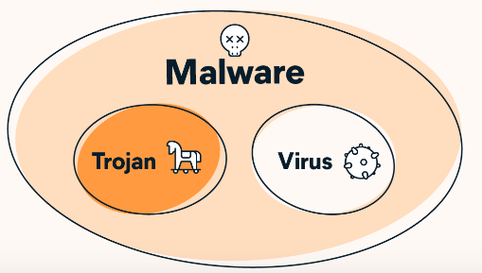
Malware: Trojan
Trojan horse malware is a file, program, or piece of code that appears to be legitimate and safe but is actually malware.
packaged and delivered inside legitimate software
often designed to spy on victims or steal data
Notes:
Trojans need you to install them.

Slide 49
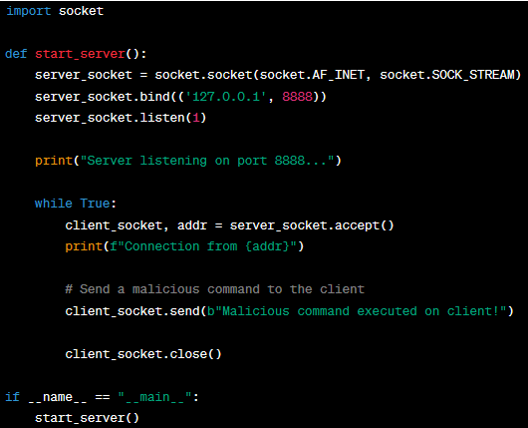
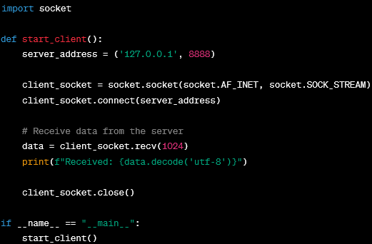
Trojan Horse (Basics)
Notes:
basic client-server application where the client is unwittingly doing something unexpected, simulating the behavior of a trojan horse.
the server sends a message to the client, simulating a malicious command, where the client unknowingly performs actions that may be harmful.

Slide 50
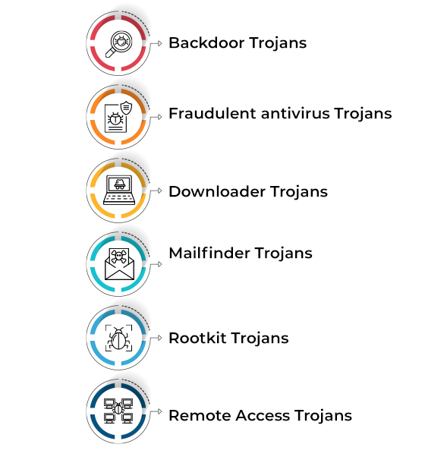
Malware: Trojan
Banking Trojans
- Zeus Trojan (2007)
DDOS Trojans
Exploit Trojans
Gaming Trojans
Infostealer Trojans
Ransomware Trojans

Slide 51
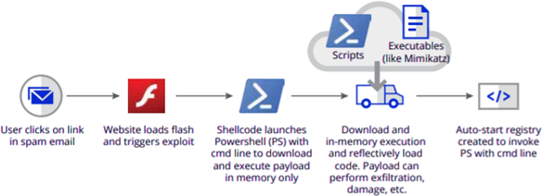
Malware: Fileless
Fileless malware can remain undetected because it’s memory-based (RAM)
does not write any part of its activity to the computer's hard drive
increasing its ability to evade antivirus software
Malware of this type is designed to work in-memory, so its existence on the system lasts only until the system is rebooted
Frodo, Number of the Beast, and The Dark Avenger

Slide 52
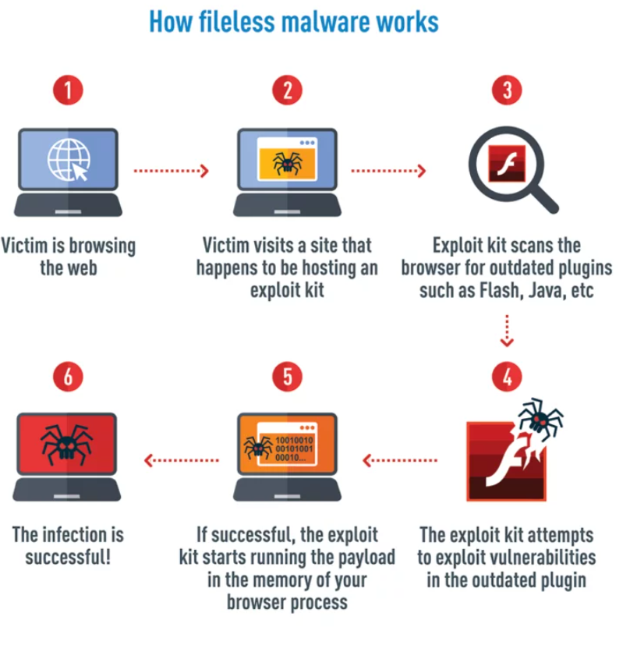
Fileless Malware

Slide 53
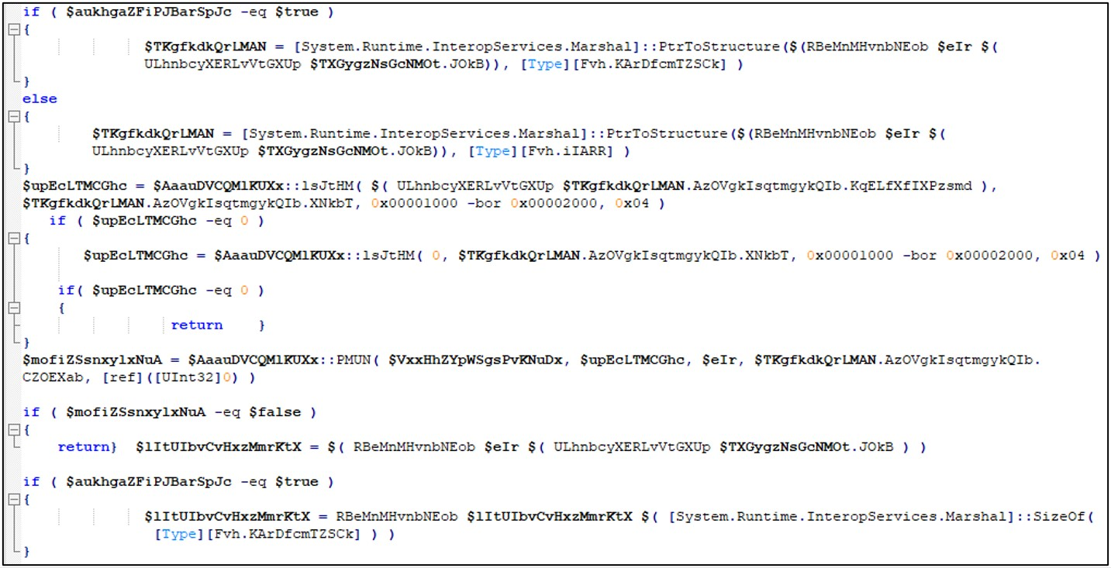
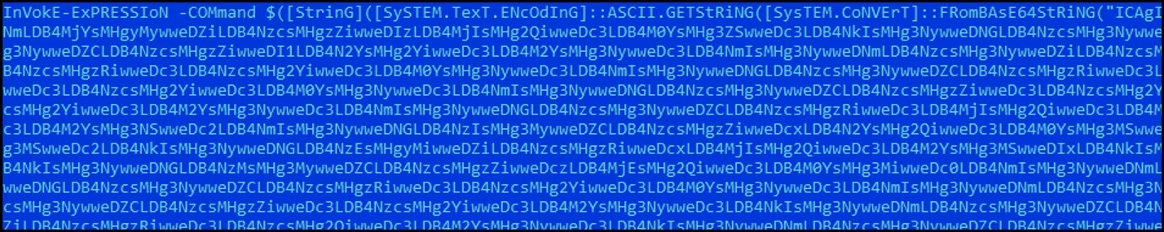
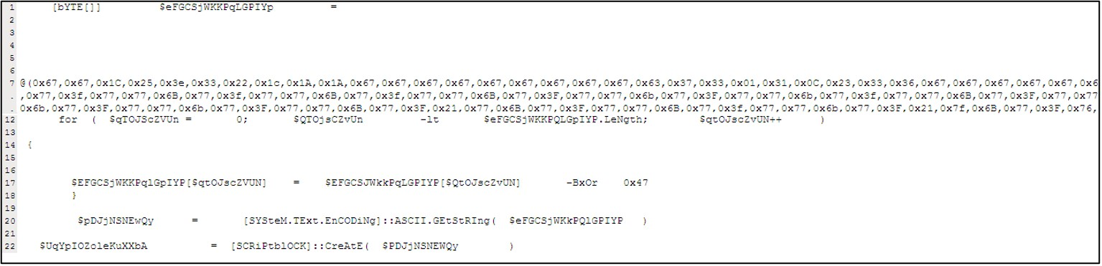
Netwalker
https://www.trendmicro.com/en_za/research/20/e/netwalker-fileless-ransomware-injected-via-reflective-loading.html

Slide 54
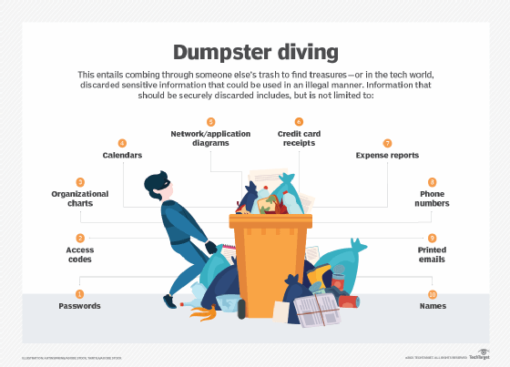
Dumpster Diving
phishing (mostly) by sending fake emails to the victims that appear to have come from a legitimate source
information obtained by compromising the confidentiality of the victim is used for Identity frauds

Slide 55

Dumpster Diving :Precautions
Practice Storage Media Deletion
Implement a Trash Management Plan
Enforce a Data Retention Policy
Use a Shredder
Keep Trash in a Safe Location Before Disposal
Use Trusted Recycling Companies
Educate / Awareness

Slide 56
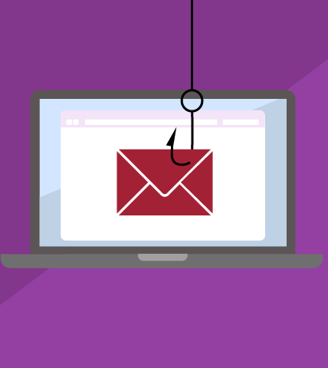
Phishing
type of email attack in which an attacker tries to find sensitive information of users in a fraud manner
through electronic communication by pretending to be from a related trusted organization
emails are carefully designed by attackers to target a group
clicking on a link installs malicious code on the computer
Stealing bank transaction passwords from users
Stealing login credentials from users

Slide 57
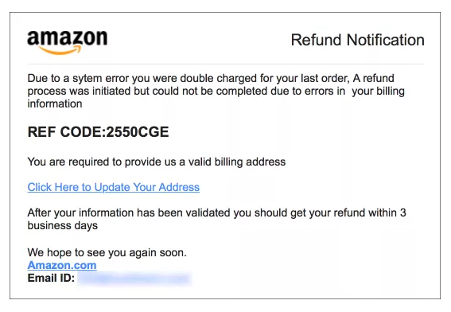
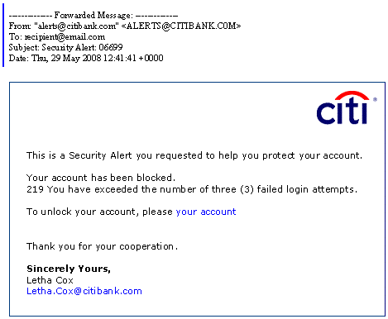
Phishing
Email Phishing
Spear Phishing
Whaling
Clone Phishing
Voice Phishing (vishing)
SMS Phishing (SMishing)
Calendar Phishing
Link Manipulation / Filter Evasion/ Social Engineering

Slide 58
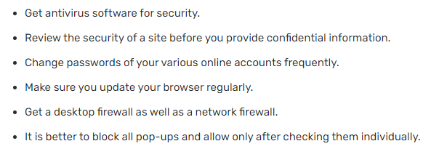
Phishing : Precautions

Slide 59
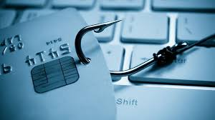
Social Engineering
Social engineering is a manipulation technique that exploits human error to gain private information, access, or valuables
tend to lure unsuspecting users into exposing data, spreading malware infections, or giving access to restricted systems
online, in-person, and via other interactions
Goals:
Sabotage: Disrupting or corrupting data to cause harm or inconvenience
Theft: Obtaining valuables like information, access, or money

Slide 60
Social Engineering: Recent
$100 Million Google and Facebook Spear Phishing Scam
Email phishing attack imitates US Department of Labor
Russian hacking group targets Ukraine with spear phishing
Deepfake Attack on UK Energy Company (vishing)
$75 Million Belgian Bank Whaling Attack
High-Profile Twitters Users’ Accounts Compromised After Vishing Scam
Texas Attorney-General Warns of Delivery Company Smishing Scam

Slide 61
Social Engineering : Techniques
Phishing
Dumpster diving
Shoulder surfing
Pharming (DNS cache poisoning)
Tailgating
Hoaxes
Impersonation
Baiting
Identity Fraud
Quid Pro Quo
Social Media And Influence Campaigns

Slide 62
Denial-of-service (DoS) Attack
render a service inaccessible
legitimate users are unable to access information systems, devices, or other network resources
Services affected may include email, websites, online accounts (e.g., banking), or other services
accomplished by flooding the targeted host or network with traffic until the target cannot respond or simply crashes
attacks can cost an organization both time and money while their resources and services are inaccessible
Denial of Service | OWASP Foundation

Slide 63
DoS attack
Buffer overflow
memory buffer overflow can cause a machine to consume all available hard disk space, memory, or CPU time
Flood
overwhelming number of packets, a malicious actor can oversaturate server capacity ( PING , SYN, Teardrop, Smurf)
Notes:
If the transaction overwrites executable code, it can cause the program to behave unpredictably and generate incorrect results, memory access errors, or crashes

Slide 64
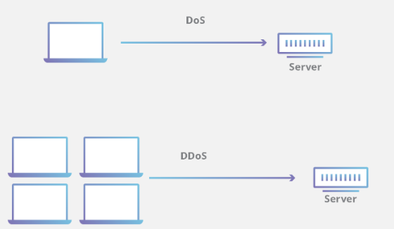
DoS attack
Slow network performance such as long load times for files or websites
Inability to load a particular website such as your web property
Sudden loss of connectivity across devices on the same network

Slide 65
DoS vs DDoS
DoS | Points of Difference | DDoS
A single computer and IP address is used to launch an attack. | Source | The source of the attack comes from multiple locations that include compromised computers, webcams and IoT devices.
DoS attacks are initiated using scripts or tools. | Tools | DDoS attacks are initiated with botnets.
DoS attacks are slower to execute. | Delivery Speed | DDoS attacks are faster to execute.
Easier to block. | Blocking Attack | More difficult to block due to the volume of machines used to execute the attack.
Easier to trace since only single device is in play. | Traceability | Tracing the true party is challenging since they can hide behind various compromised systems.
Buffer Overflow, Ping of Death, Teardrop | Attack Types | Volumetric, Fragmentation, Application Layer

Slide 66
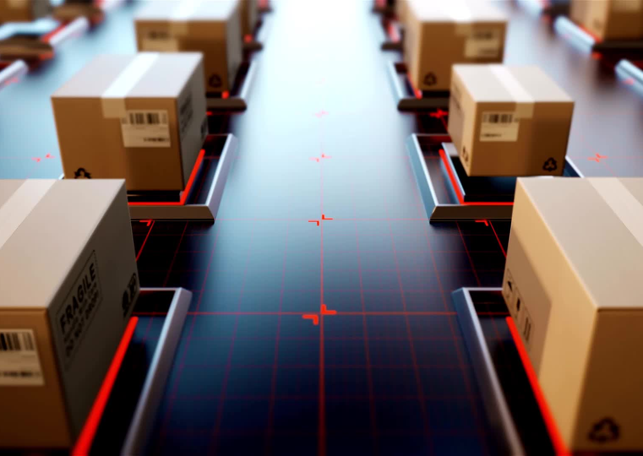
DoS Mitigation
Attack Detection (Pattern and behavior blocking)
Web Application Firewall (Traffic scrubbing, Source or location blocking)
Bot management
API security
Rate limiting
Displaying CAPTCHA

Slide 67

SQL Injection
SQL injection is a code injection technique that might destroy your database

Slide 68


SQL Injection
an attacker inserts or "injects" malicious SQL code via the input data of the application
SQL injection allows the attacker to read, change, or delete sensitive data as well as execute administrative operations on the database
works on interpreters

Slide 69


SQL Injection …
set year variable to 0 OR 1=1
shows all orders in the database
reveals credit card database!

Slide 70


SQL Injection…
user generates this query:
a denial of service attack
user takes over machine!

Slide 71
SQLi : Types
In-Band Sqli : same channel of communication to launch their attacks and to gather their results
simplicity and efficiency
Error-based SQLi—the attacker performs actions that cause the database to produce error messages (eg using ‘)
Union-based SQLi—this technique takes advantage of the UNION SQL operator

Slide 72
SQLi: Types
Inferential (Blind) SQLi: hacker sends malicious data payloads, then reconstructs the database server’s structure using the web application’s response
Boolean-based SQLi : response depending on whether the query returns TRUE or FALSE ( eg; ' AND 1=1 --+)
Time-Based SQLi : query to the database and forcing it to wait for a predetermined length of time (in seconds) before answering ( eg: And SLEEP(10) if sleep then Vulnerable)
Types of SQL Injection (SQLi) – GeeksforGeeks
Time-Based Blind SQL Injection Attacks

Slide 73


SQLi : Example

Slide 74

SQLi : Prevention and Mitigation
Input validation (sanitization): the practice of writing code that can identify illegitimate user inputs
Parametrized queries
Web application firewall (WAF)

